Slide 1
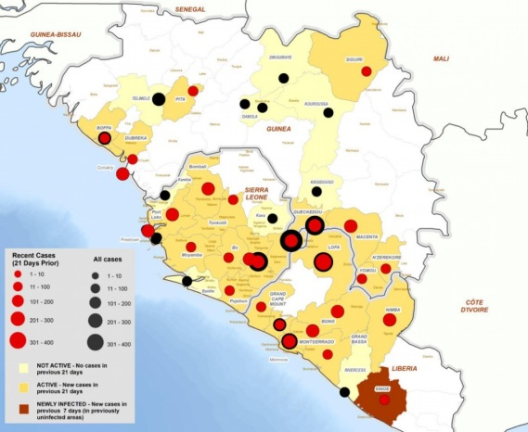
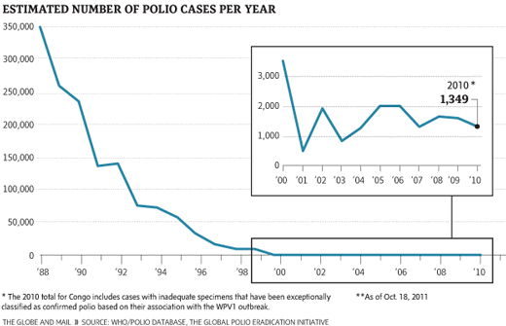
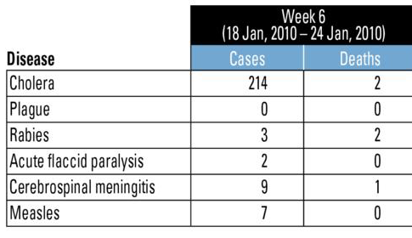
Computing and Global Health
Lecture 2, Surveillance
Winter 2015
Richard Anderson

Slide 2
Today’s topics
Surveillance problem
Issues
Health Information systems
HISP/DHIS2
Approaches to last mile data collection

Slide 3
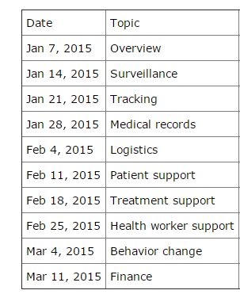
Readings and Assignments
Homework 1
  Design a national immunization equipment monitoring system
Readings
  DHIS2 for Ghana
  Health worker personas
  Lancet Health

Slide 4
Assignment 2
Develop requirements for a software tool to support the district manager in aggregating facility reports and submitting them to the national level.
  Select one of your three countries as a target
You may choose the most appropriate level/approach for the requirements

Slide 5
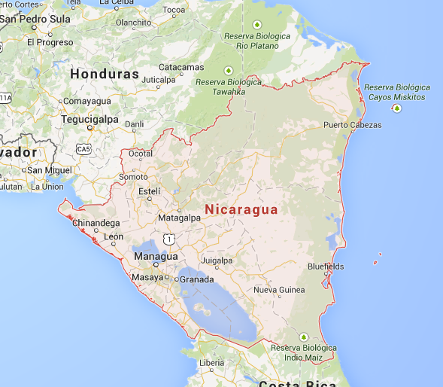
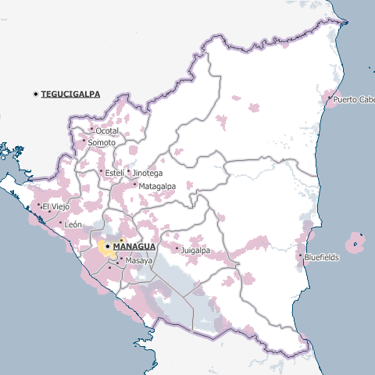
Nicaragua Case Study
Strong national epidemiology department
Second poorest country in the Americas (GDP per capita $4500)
Population 5.8 million

Slide 6
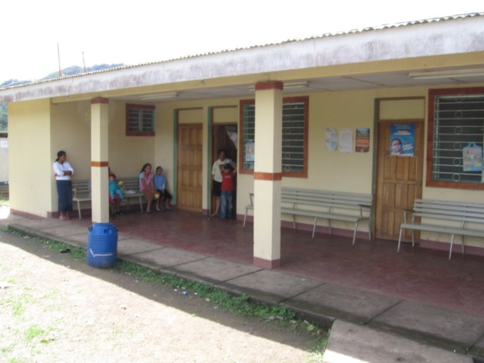
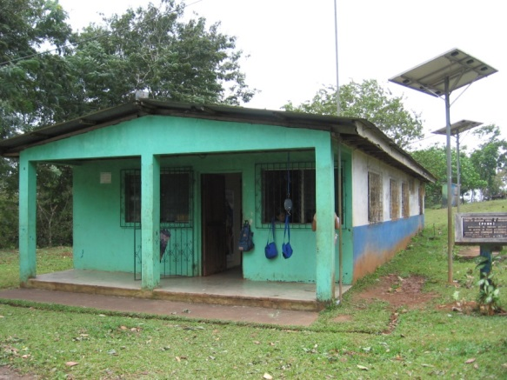
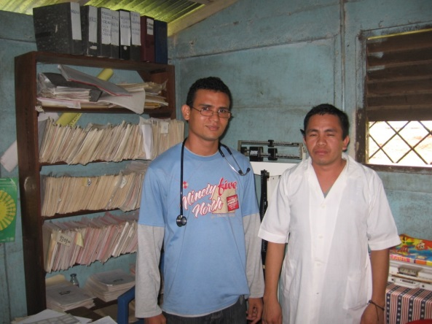
Nicaragua Health System
SILAIS (district health office), Hospital, Health center, Health post
Health post, staffed by one or two people
Weekly meetings of health post staff at health center

Slide 7
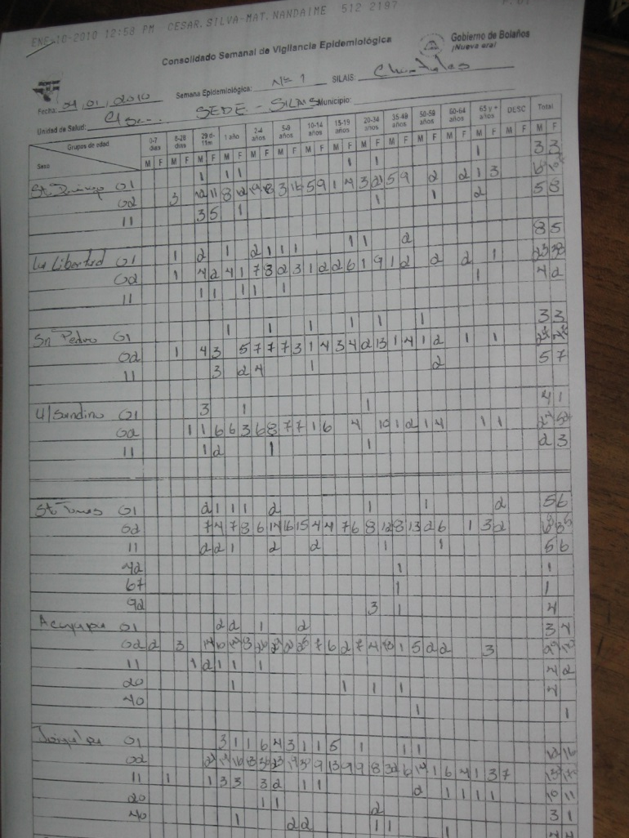
Facility reporting
Monthly reporting of disease
  Roughly 60 diseases listed
  Age buckets and gender
Separate immunization reporting
Additional reporting from hospitals
Health Post -> Health Center -> Silais -> National

Slide 8
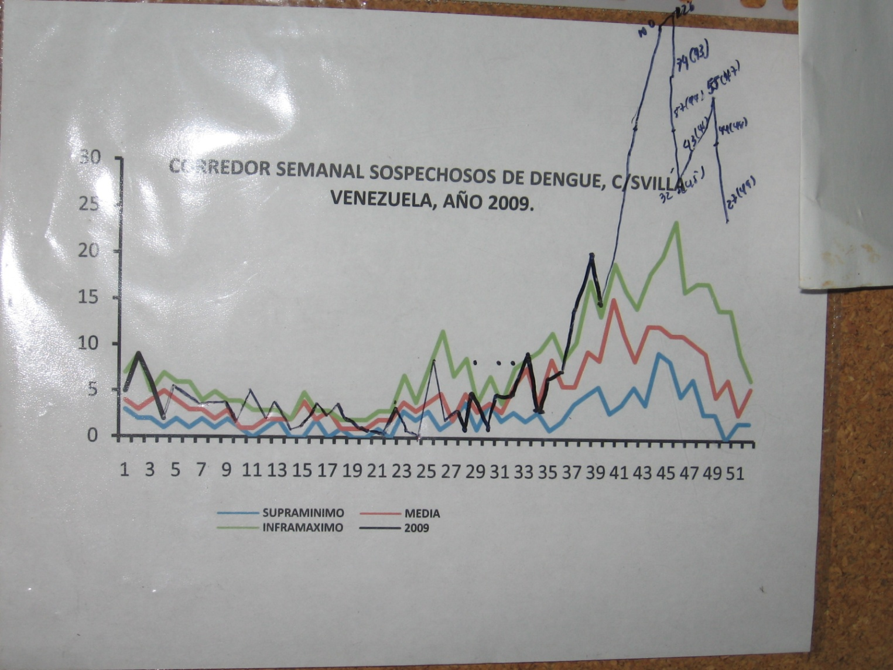
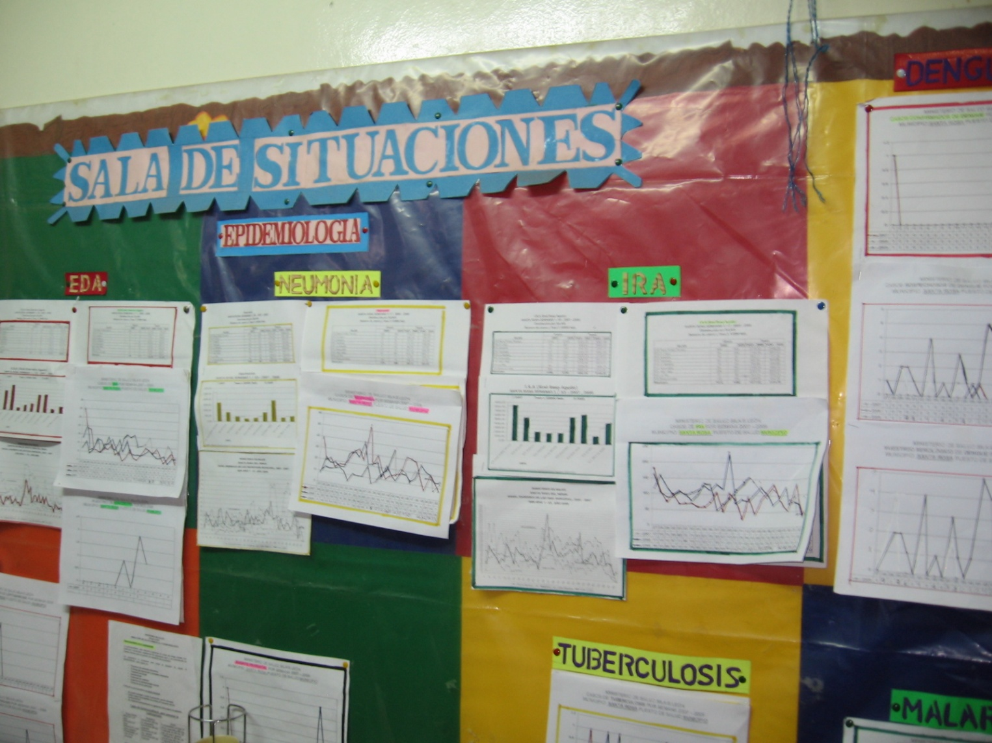
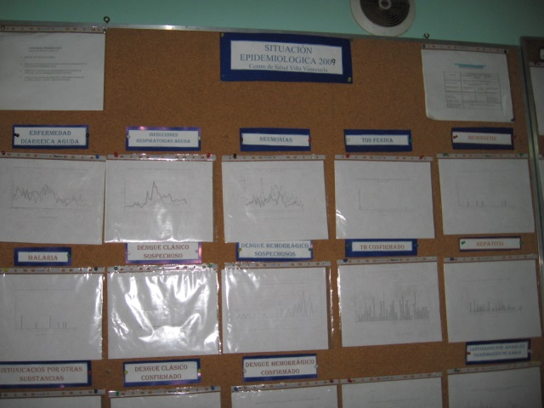
Data use
Strong culture of data use
All health centers visited had recent graphs of health data
Staff expressed understanding of data and awareness of how it can be used
Policy and training to support data use

Slide 9
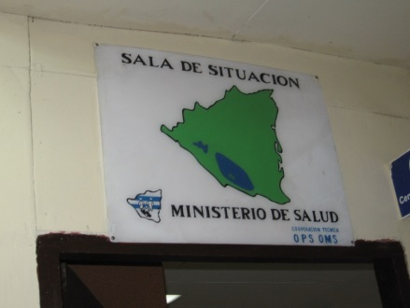
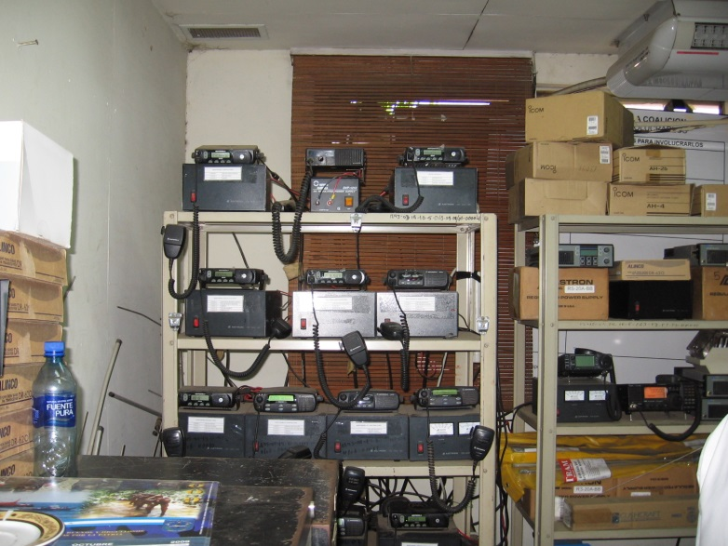
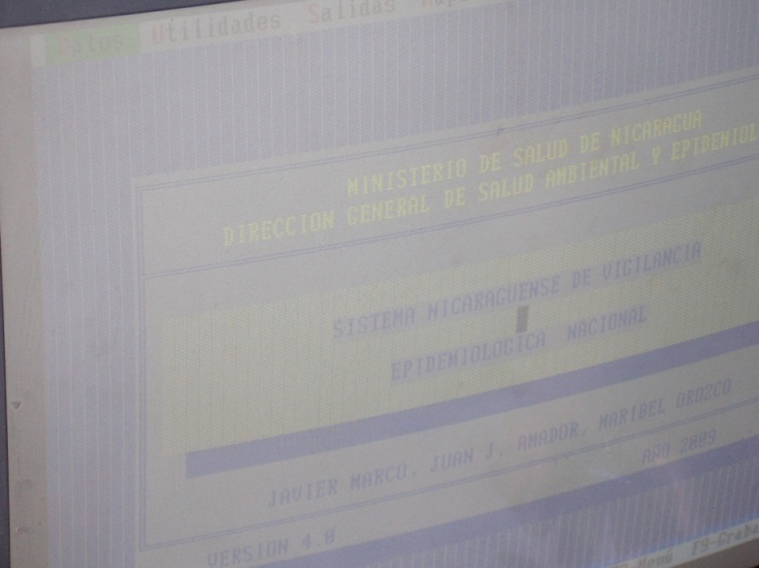
National Level
Well established national reporting
  Procedures for data collection and use in place
  Run by epidemiologists
Remote reporting by radio
  Gradually being phased out
Custom surveillance software (running on Windows 3.1 in 2010)

Slide 10
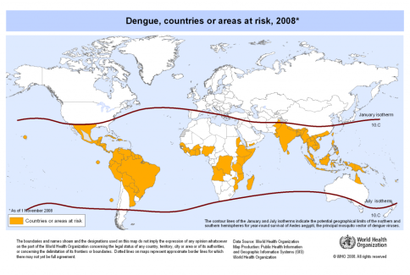
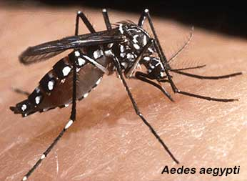
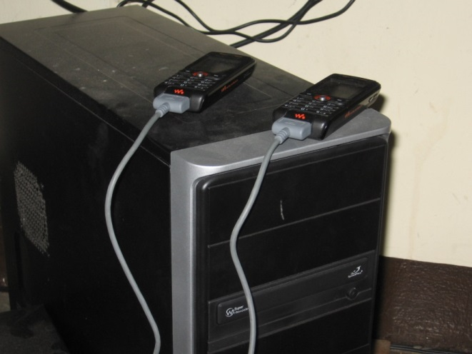
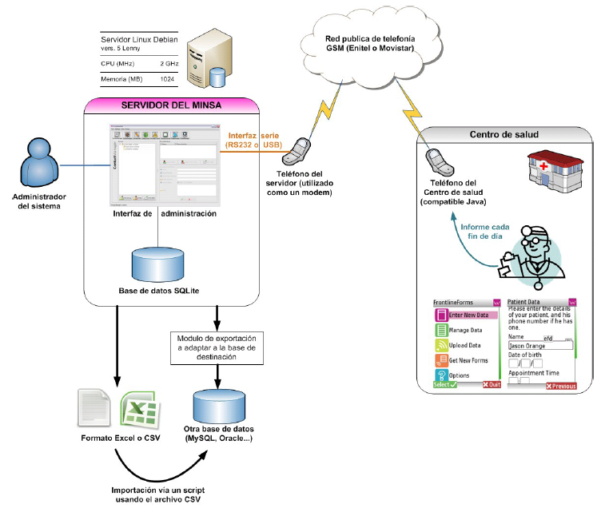
Dengue Surveillance
Mosquito born disease of growing importance
  Breakbone fever
  Highly seasonal
Case tracking
  Early warning of outbreaks
  Mitigation (e.g., mosquito control)
  2009 Nicaragua introduced a Frontline SMS reporting system

Slide 11
Nicaragua Summary
Relatively successful surveillance system
  Procedures appear to work
  Understanding of use of data
Multiple different reporting systems in place as of 2010 with out of date technology
Country faces challenges of low income and remote areas
Strengths
  Strong public health system
  Small country
  Improving infrastructure

Slide 12
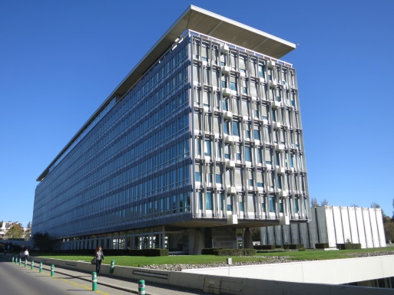
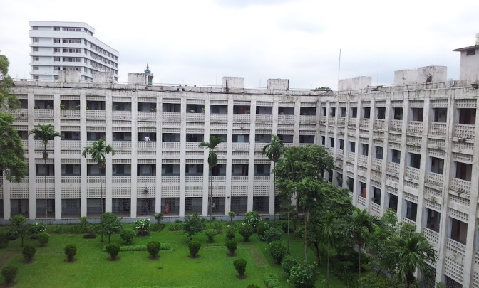
Surveillance
Collect aggregate health data at national level
Not associated with the individual
Health statistics, not data for treatment of individuals

Slide 13
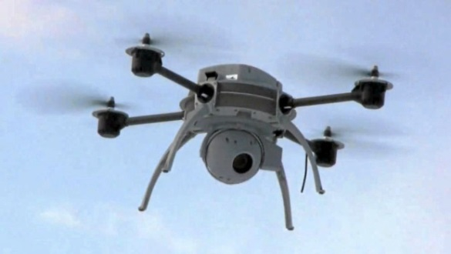

Routine surveillance vs. Surveys
Country surveillance
NGO led survey
Routine submission with a fixed period
Goal of complete coverage
Data collection and entry one of many tasks by workers
Small amount of data per form
Limited resources for training, implementation, and supervision
Single instance
Goal of statistical significance through sampling
Data collection by dedicated workers
Complex data collection
Large amount of data

Slide 14
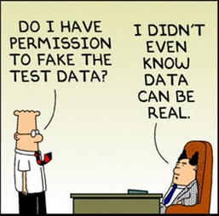
Challenges
Standard problems associated with surveys
  Statistical significance
  Form design
  Data errors
ICTD Problems
  Peripheral Data Collection
  Health information systems for developing countries

Slide 15
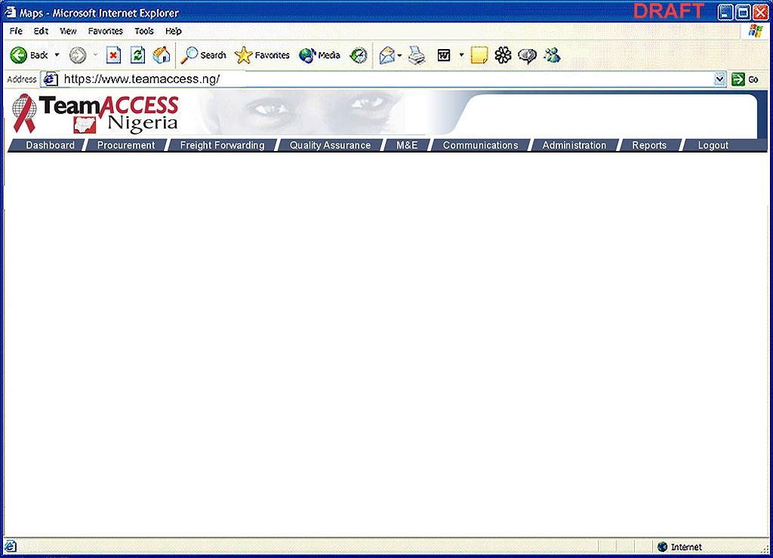
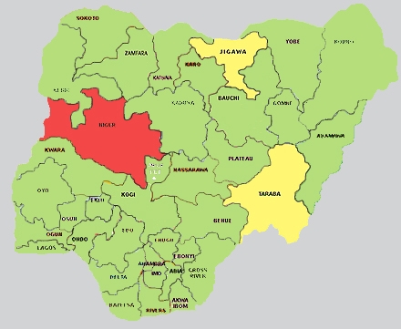
What if the information you needed to make any decision was easy to access?
Dashboard
User ID: 20125
Name: Kayode Emeagwali
Role: Team Access Country Administrator
ALERTS
KEY PERFORMANCE INDICATORS
MAP
ALERT (3of 6)
Last 24 hours
Last 24 hours
Percent of critical items available within the 100%
SCMS system.
Percent of non-critical items re-supplied 99%
within 30 days.
Average number of commodities provided 150
per program.
Percentage of emergency orders per month. 3%
Number of patients receiving services
through SCMS:
  Care and support 72,000
  Palliative care 15,000
  ART 60,000
Number of sites with deliveries within
7 days: 20
12/20/04 06:58 am Team Access recalls batch # 2434-FG78.
12/20/04 04:15 am Facility 21 reports an adverse event from its latest shipment of Didanosine.
12/20/04 00:35 am Facility 5, please provide a count of batch# 2435-FH95.
More
CRS
CRS
TRACK AND TRACE
Enter Order Number
Search
CRS
AFRICAN
ORDER VOLUME
DELIVERY PERFORMANCE
ALL
ALL
CRS
FHI
FUTURE
CARE
OTHER
# OF
DAYS
PARTNER SITES
SITES
Select a program
ARV SITES
PARTNER SITES
CRS
ALL
CRS
FHI
FUTURE
CARE
ARV DRUG SUPPLY FORECAST
ARV DRUG SUPPLY COLOR KEY
Select a date range
NO SHORTAGE
SHORTAGE
STOCKOUT
30 DAY
30 DAY
60 DAY
90 DAY
DATE
2005
DATE
2005

Slide 16
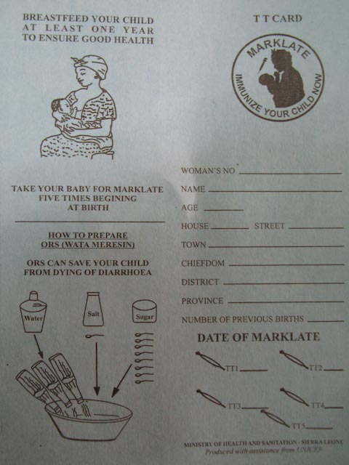
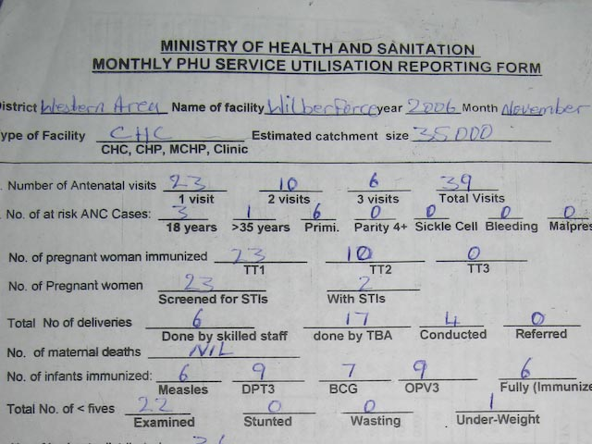
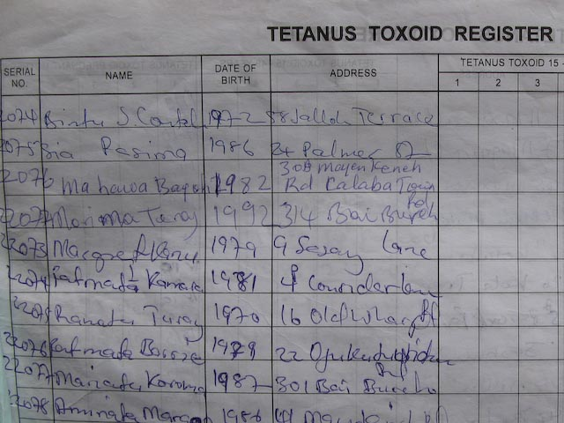
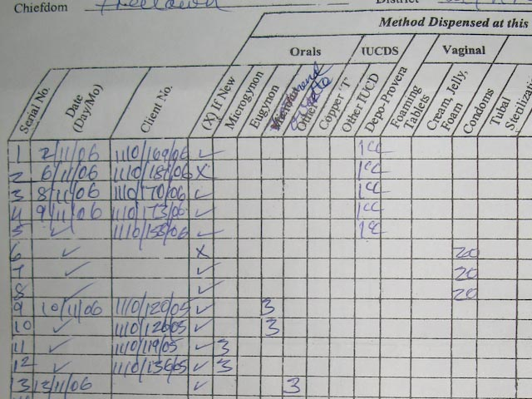
Forms

Slide 17
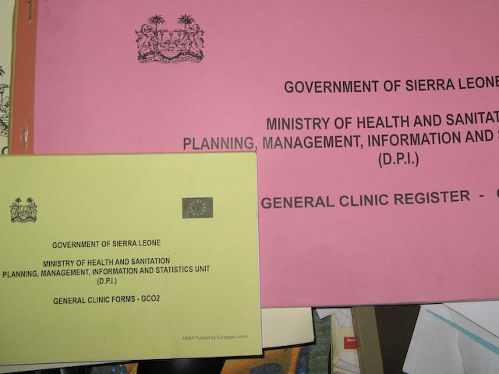
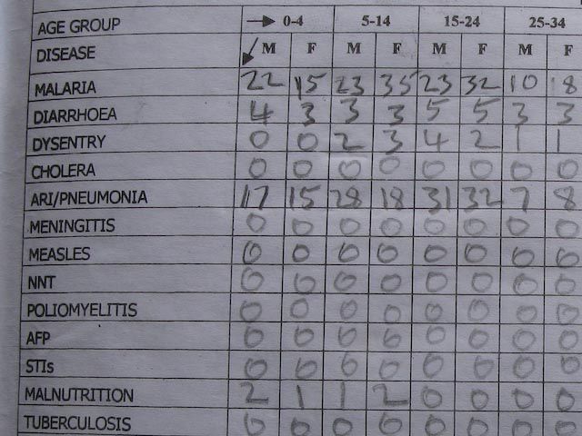
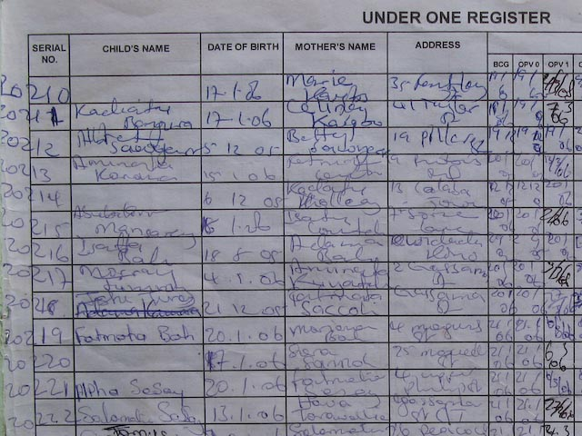
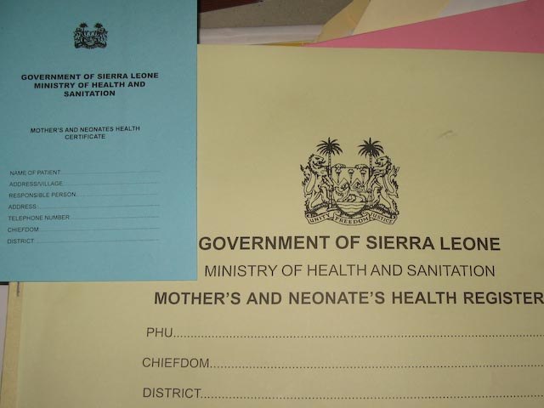
Forms

Slide 18
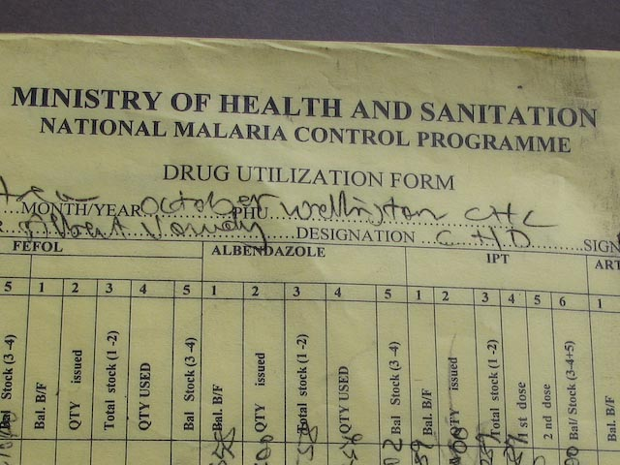
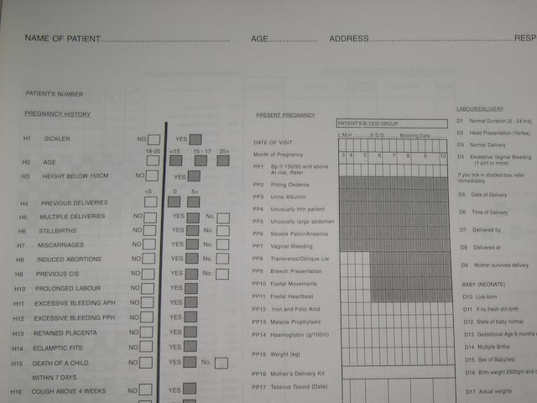
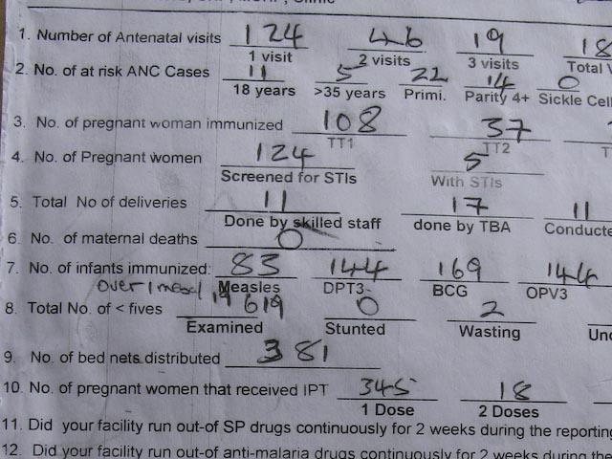
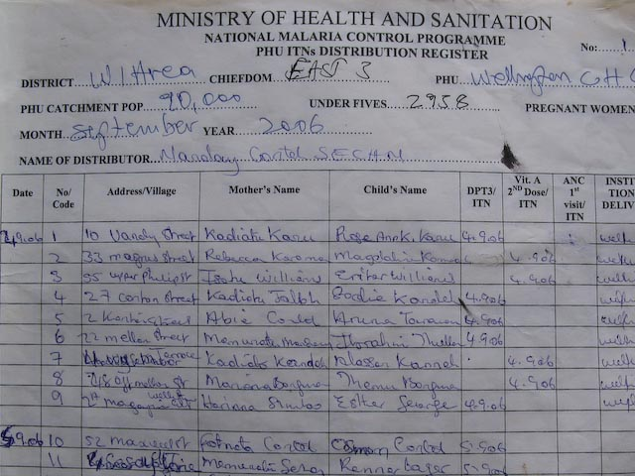
forms

Slide 19
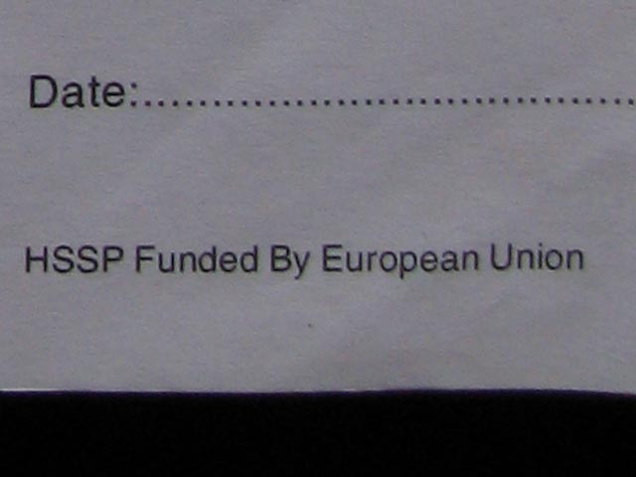
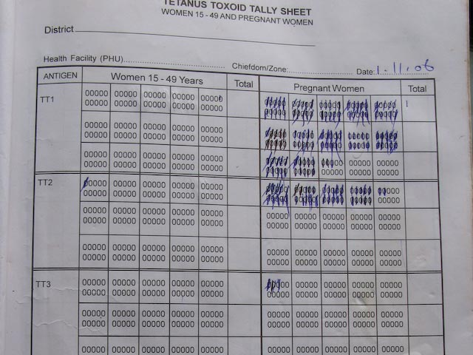
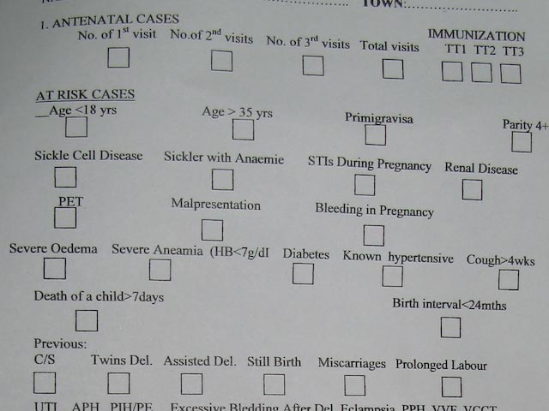
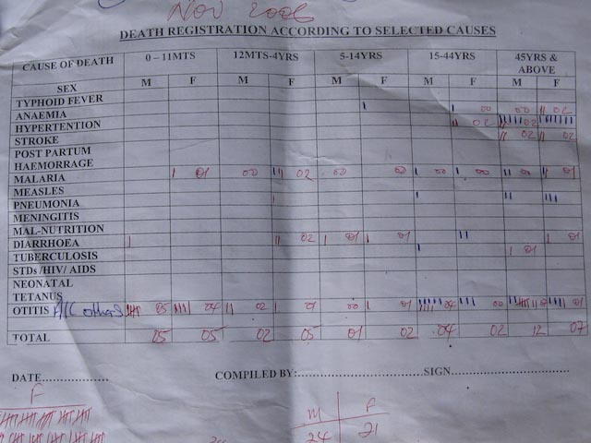
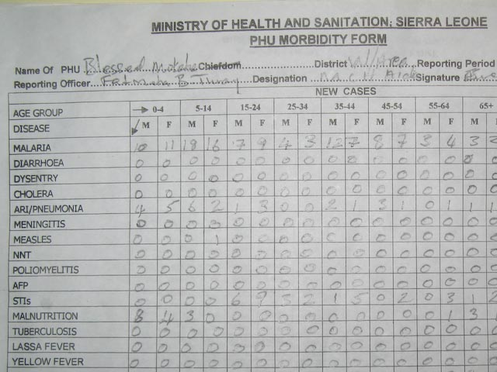
forms

Slide 20
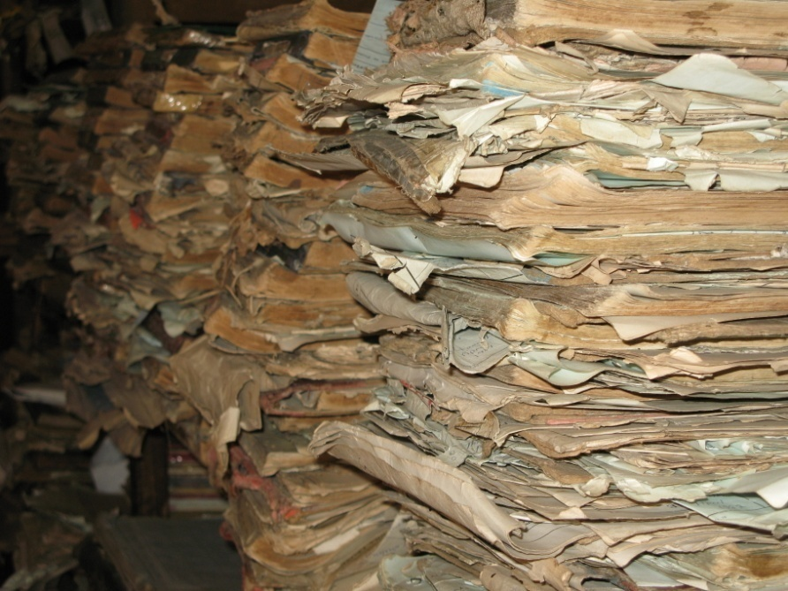

Slide 21
Key Issues
Why collect data
What are indicators
Institutional challenges
  Pressure of Data collection from the top
Practical challenge
  Reporting takes too long
Getting data to be used
Data at the facility level
Processes in data reporting
Role of technology for data collection

Slide 22

Why collect data ?
External
  Donors, Global bodies, Research
Global program goals
  Elimination of Polio – need to know all suspected cases (AFP): polioeradication.org
Strengthen country programs
Allocate resources
Address specific problems

Slide 23
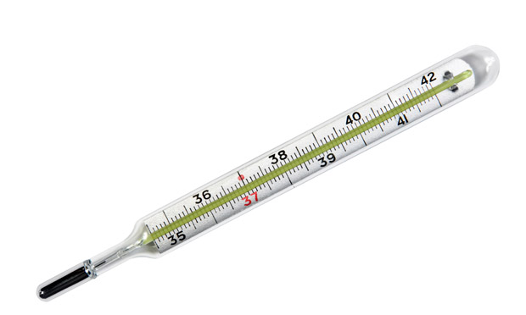
What are indicators?
Measurable variable to assess underlying variable
  Attendance at church to measure religiosity
How to measure quality of immunization
  Percentage of kids receiving 3rd dose of BCG
Issues
  Standardization
  Denominators
  Indicator growth

Slide 24
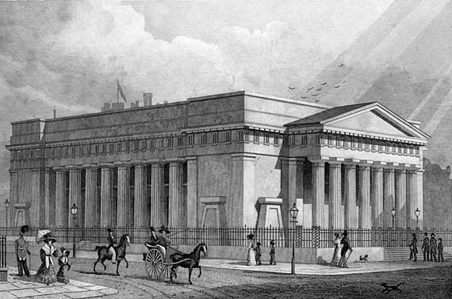
Institutional challenges
Indicators established at the central level
Data collected at the facility
Pressure from Donors to collect domain specific data
  Explosion of data required
  Development of parallel information systems

Slide 25
Data Latency
Data registration and collection latency
Data reporting and capturing latency
Data transmission latency
Data processing and analysis latency
Data feedback and dissemination latency

Slide 26
Data use
Everybody wants this to happen
Requires lots of work to make this happen
Organizational and political
Information use maturity model
Technically working information system, emphasizing data completeness
Information system characterized by analysis, use and feedback of data
Information system shows evidence of impact on decision-making

Slide 27
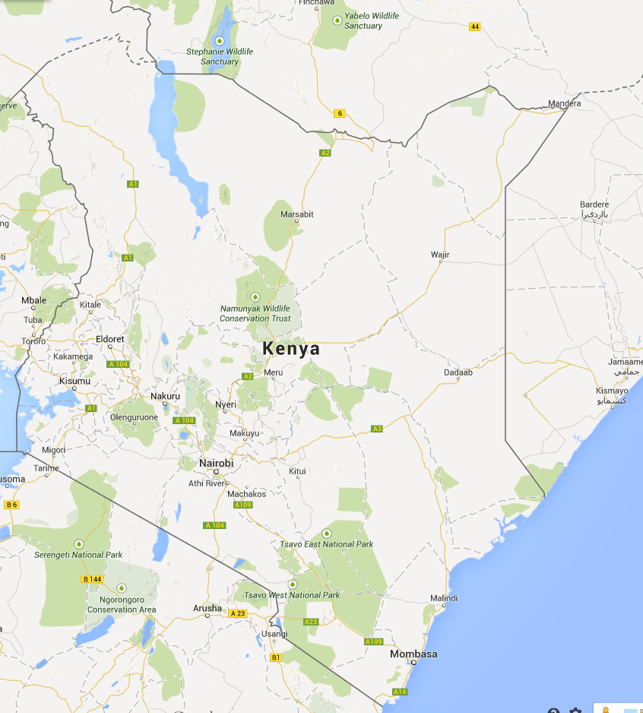
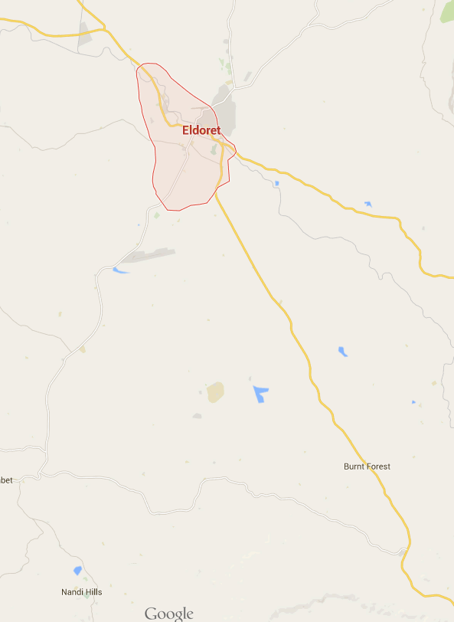
If no one uses data, its probably wrong

Slide 28
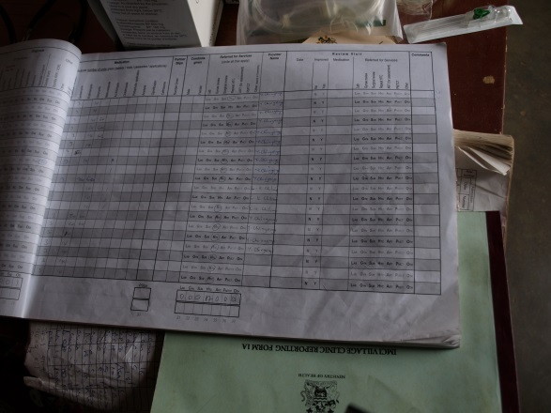
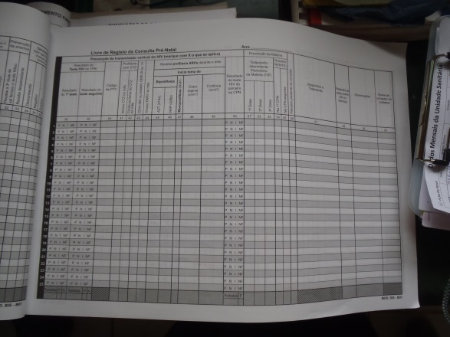
Facility environment
Differences in scale between different types
  Hospital: Administrative staff, multiple doctors
  Health Center: Small number of doctors
  Health post: one or two health workers
Data kept in registers
  Dozens of different registers

Slide 29

Data Flow Today

Slide 30
Processes
Data entry
Data submission
Data approval
Data aggregation

Slide 31

Role of information and communication technology
Data entry
Data transport
Aggregation
Storage
Use

Slide 32


Data reporting technologies
Web forms
eMail
Feature phone
Smart Phone
SMS
Paper to Digital

Slide 33





Health Information Systems

Slide 34
2x2 Architecture Grid (Lubinski)
Global Common Architecture Requirements Standards Guidelines etc. | Country Specific Architecture
Global Common Solutions | Country Specific Solutions Software Hardware Services etc.
1
2
Services in global context
Services in country context
3
4
Products in global context
Products in country context

Slide 35

Conceptual HIS Framework
Data Sources
Integrated Health Information System
Dashboard,
Reports,
Queries,
Events & Alerts
HIS Actors
Using Evidence for Decision Making
Census
Individual
Records
Integrated
Data
Repository
Civil
Registration
Service Records
Extract
and
Integrate
Data
Senior Country Official
National Public Health Official
Population
Surveys
Resource
Records
International M&E Officer
District Health Manager
Senior Country Official
Facility Health Officer
Routine and Non-Routine
Data Collection Activities
Civil Society
Policies, Resources and Processes
Notes:
1/14/2015
35

Slide 36
General Problem
Information system integration
  Parallel systems
  Uniform system
Enterprise architecture
  But countries are not companies

Slide 37
Integrated health data reporting
National issues
Stake holder conflicts

Slide 38



Data reporting architectures
Web based
PC based

Slide 39








PC Applications are not dead yet!
CCEM: Cold Chain Equipment Manager
Microsoft access software for managing inventory of vaccine cold chain equipment

Slide 40



HISP
Health Information System Program
  University of Oslo, Norway
  Informatics Program with global ties
  Manages DHIS2 software
  Focus on Action Research

Slide 41
DHIS2
District Health Information System 2
Open source software for health system data reporting
  Submit monthly reports
  View data
Design allows customization at country level

Slide 42



HISP History
Initiated in post apartheid South Africa
  Improve public health system
  Activist led
  Scandinavian participatory design and action research
Open source application built on top of MS Access for South Africa
Introduction to other countries
  Mozambique, India, Vietnam, Cuba
  Technical and political challenges
Transition for DHIS 1.4 to DHIS 2.0
Development of University Programs
Establishment of HISP India to support state wide rollout in India
Adoption of DHIS2 in multiple countries as national HIS

Slide 43


DHIS2 Deployments

Slide 44
DHIS2 concepts and data models
Data elements: atomic units (but can be disaggregated by dimensions age/sex)
Data set: collection of data elements
Period: Dates (with periodicity)
OrgUnit: Location
Indicators

Slide 45


Slide 46


Slide 47



Open Source
HISP Oslo manages DHIS2 as a global, open source project
BSD License
Distributed development
  India, Vietnam, Norway
Strong emphasis in developing country capacity
  DHIS2 Academy

Slide 48
HISP Case Study

Slide 49

HISP Case studies

Slide 50
Health Information Systems
Challenges
  Collection of irrelevant data
  Poor data quality
  Poor timeliness of reporting
  Parallel and duplicate data collection
  Low information usage and poor feedback
Donor driven reporting
  Lack of requested data elements in national reporting
  Development of parallel reporting systems

Slide 51

DHIMS
2007: Roll out of District Health Information Management System
2008: Health Metrics Network (HMN), framework for integrated HIS
2011: Implementation of DHIMS2 in DHIS2

Slide 52
DHIMS2 vs. DHIMS
Centralization of expertise
  Greater expertise needed, but can be centralize
Improved data flow and reporting speed
Increased access to information
  No longer restricted to a local database
Consistent national deployment
  Avoid inconsistent development in different areas
Substantial capacity development

Slide 53



Why Open Source?

Slide 54
Last mile data reporting

Slide 55
Internet

Slide 56
Feature phone

Slide 57
Smart phone / ODK

Slide 58
SMS

Slide 59
SMS Wheel

Slide 60
Paper to Digital

